Slide 1
Design Sprint
Facilitator + Facilitator / Date of design sprint

Slide 2
Who should you invite?
1. Get a Good Mix
3. Brainstorming is Not For Everyone
Try to get at least one rep from each department. The more brains from different areas, the better the output.
Make sure you manage expectations upfront. Some people might find such loose ideation stressful or frustrating.
2. Limit to 8 People
4. Schedule the Time
Over time this has become the sweet spot for the number of ideas generated versus the amount of different brains in the room.
Make sure you have at least one day of everyone’s time if it’s small in scope. Ideally, keep it to two days for medium to large problem areas.

Slide 3
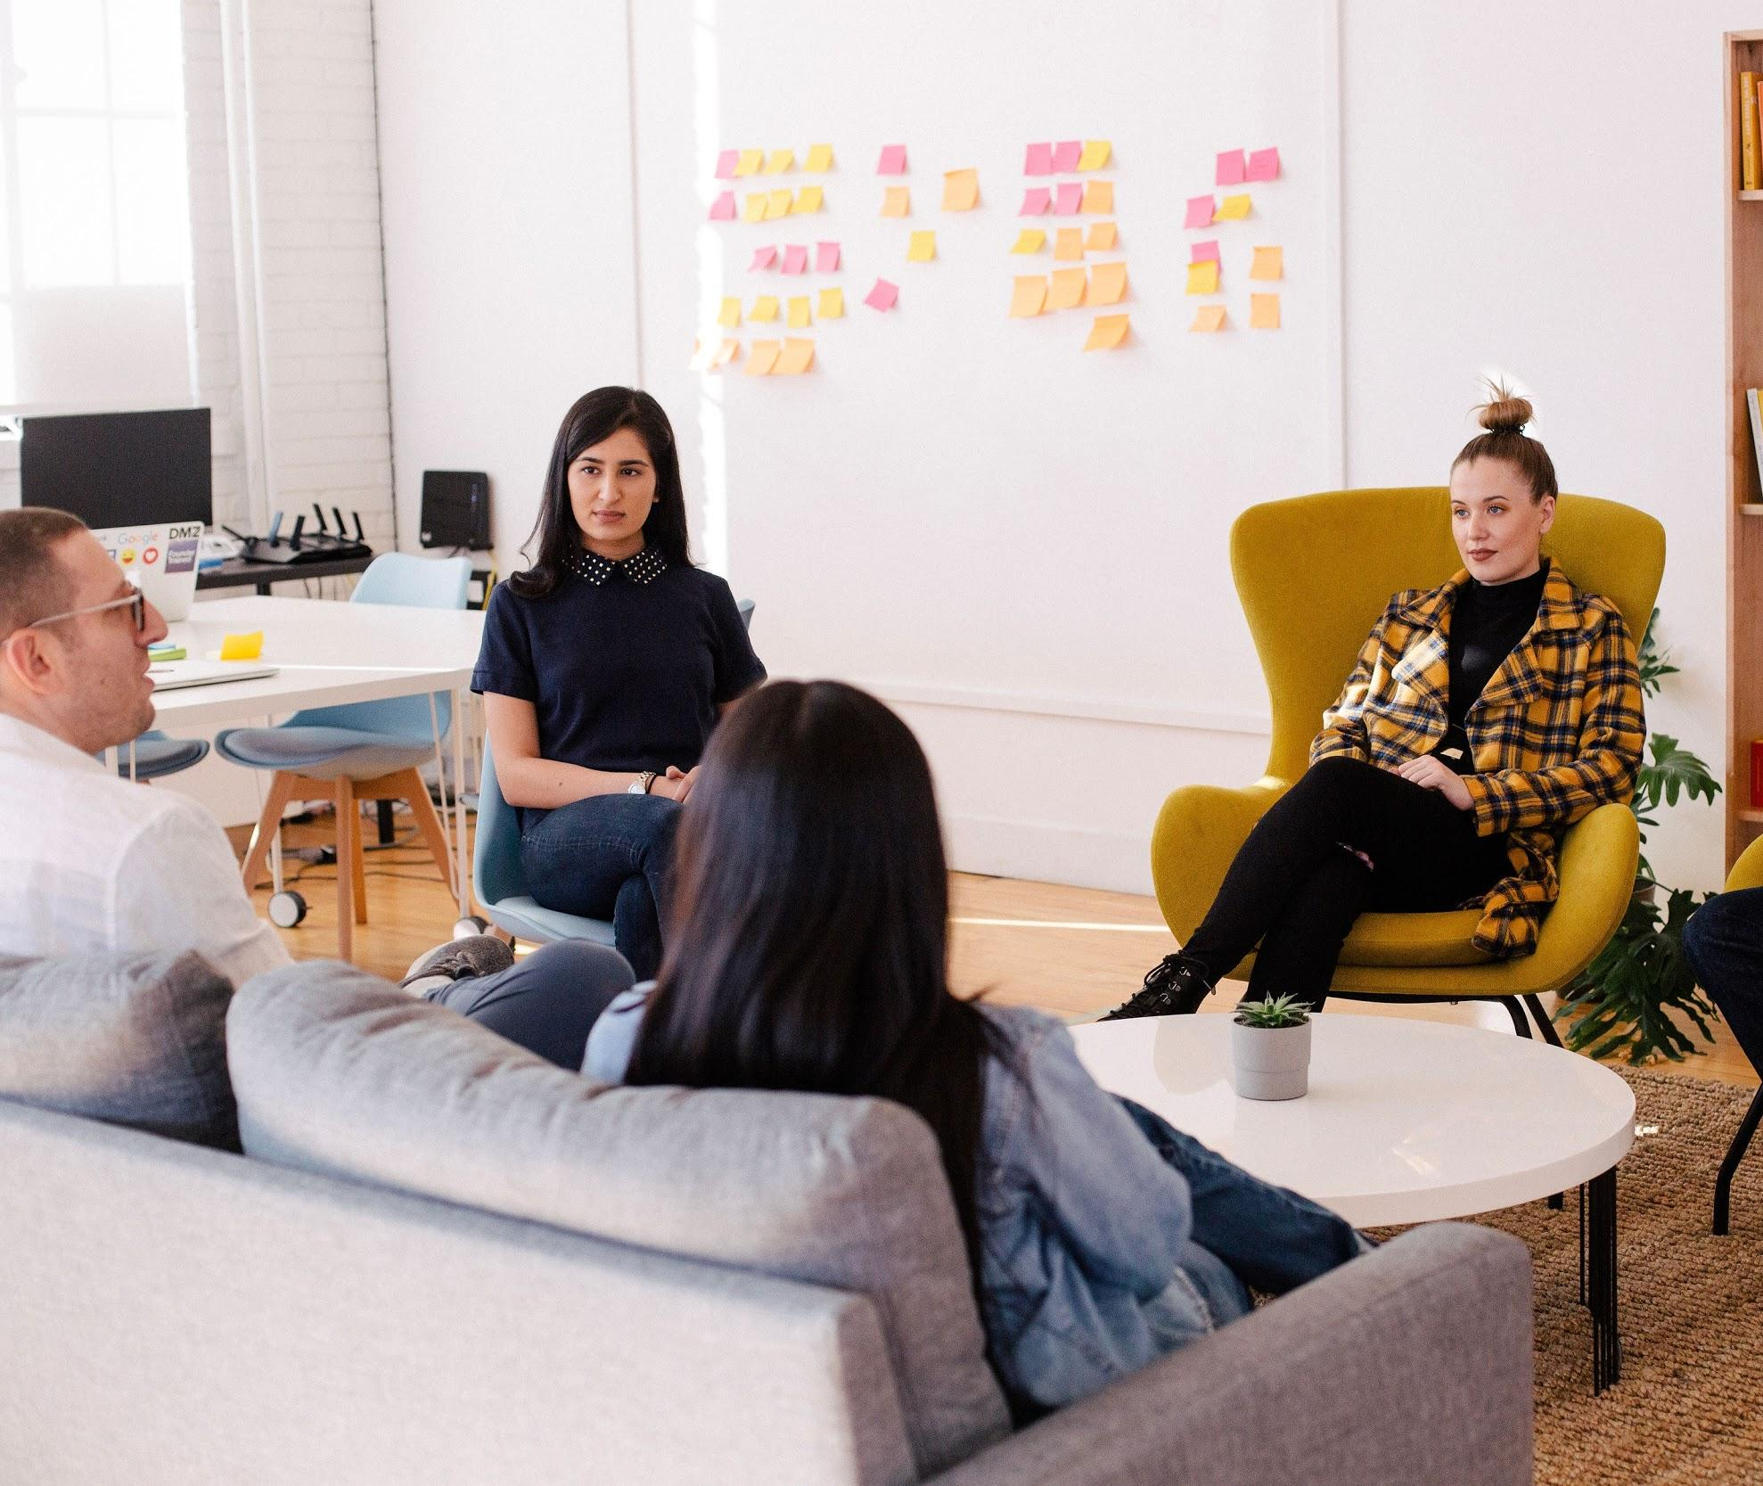
Facilitators
Facilitator Name (Title)
Facilitator Name (Title)

Slide 4
Questions? Sharing!
#slack-channel-name
You can ask questions via Slack.

Slide 5
SCHEDULE

Slide 6
Schedule - Day One
1
2
3
4
5
Day One / 9:00-9:30 : Introduction
Day One / 9:30-10:30 : Presentation
Day One / 10:30-10:45 : Coffee Break
Day One / 10:45-11:15: Research on Ideas
Day One / 11:15-12:00: Show & Tell

Slide 7
Schedule - Day Two
1
2
3
4
5
6
7
Day Two / 9:00-9:15 : Recap
Day Two / 9:15-9:30 : Crazy 8’s
Day Two / 9:30-10:00 : Polish Ideas
Day Two / 10:00-10:45 : Present Two Concepts & Discuss
Day Two / 10:45-11:00 : Coffee Break
Day Two / 11:00-11:45 : Present Two Concepts & Discuss
Day Two / 11:45-12:00 : Wrap Up/ROTI/Feedback

Slide 8
OBJECTIVE

Slide 9
START WITH THE QUESTION OF HOW MIGHT WE _____________ AND KEEP YOUR OBJECTIVE FOCUSED.
For example: 1. How might we define a better onboarding experience? 2. How might we promote trust inside our product when utilizing machine learning? 3. How might we automate and simplify creation for our customers?

Slide 10
THE MODIFIED
UNBOUNCE DESIGN SPRINT
Not a Google design sprint. The goal is to get ideas to develop concepts that we can test with users, and start exploring.

Slide 11
Diverge
Research, envision, develop lots of solutions and ideate.
Decide
Choose the best idea and storyboard the idea.
Design Sprint
Understand
Who are the users, what are their needs, what is the context, competitor review and formulate a strategy.
Prototype
Build something quick and dirty to show to users. Focus on making it beautiful.
Validate
Show prototype to real users outside the organisation. Learn what doesn’t work.

Slide 12
Additional Context
At this point you can contextualize the problem with prior research, concept testing, experience principles, archetypes, target segments, possibilities of ML/AI etc...

Slide 13
RULES OF ENGAGEMENT

Slide 14
Rules of Engagement
1. Defer Judgement
3. Build on the Ideas of Others
Creative spaces don’t judge. They let ideas flow and foster great ideas.
Being positive and building on the ideas of others take some skill. In conversation, we try to use and instead of but...
2. Encourage Wild Ideas
4. Stay Focused on the Topic
Wild ideas can often give rise to creative leaps. Don’t be afraid of wacky and out there.
Keep the conversation on target. Otherwise you can diverge beyond scope or what we’re trying to design for.

Slide 15
Rules of Engagement cont’d...
5. One Conversation at a Time
7. Go For Quantity
Always think about the challenge topic and give your input by joining a conversation not starting a new one.
Aim for as many ideas as possible. In a good session, up to 100 ideas are generated in 60 minutes. Crank the ideas out quickly.
6. Be Visual
8. Stay Analog
Nothing gets an idea across faster than drawing it. It’s all about the idea behind your sketch, not the drawing quality.
As much as possible, please leave your phones in your pockets and laptops closed (if you can!)

Slide 16
OUTPUT & NEXT STEPS

Slide 17
1. Utilize ML & AI
2. Future Proofing
3. Onboarding
Outline what you hope to accomplish by running this sprint. Below are examples.
Find new ways in which ML and AI would be useful in our industry.
Create concepts for the purpose of usability testing in future prototypes.
Reduce the amount of time it takes our customers to create for the first time.

Slide 18
UNPACKING
THE PROBLEM
45 MIN
Set the context, goal of sprint, the problem spaces that surfaced out of our research and concept tests, etc.

Slide 19
Unpack Your Primary Goal
Describe what will make the ideal experience successful and what obstacles users face. Contextualize the pain points. For example: Onboarding.

Slide 20
What does it mean for your team/company?
Explain how the primary goal increases the value of your product to your customers, and how that value translates into business metrics that matter to you (examples below):
ONBOARDING (MRR)
ADOPTION (GROWTH)
STICKINESS (CHURN)

Slide 21
COFFEE
BREAK
15 MIN

Slide 22
POLISH YOUR IDEAS

Slide 23
RESEARCH
45 MIN
Everyone take time to research individually. Take your own notes. What is out there on advertising, website and design platforms etc... How may we...
”REPEAT YOUR OBJECTIVE HERE”

Slide 24
Repeat The Goals & Value
Communicate your goals of the sprint again and recap the value and what it means to your company/team.
POINT ONE
POINT TWO
POINT THREE
POINT FOUR

Slide 25
PRESENT CONCEPTS & DISCUSS

Slide 26
SHOW & TELL OF YOUR RESEARCH
45 MIN
Please share your findings with the rest of the group. Best onboarding practices, great brand guidelines, advances in technology etc...
”REPEAT YOUR OBJECTIVE HERE”

Slide 27
DAY 2: WELCOME BACK

Slide 28
Schedule - Day Two
1
2
3
4
5
6
7
Day Two / 9:00-9:15 : Recap
Day Two / 9:15-9:30 : Crazy 8’s
Day Two / 9:30-10:00 : Polish Ideas
Day Two / 10:00-10:45 : Present Two Concepts & Discuss
Day Two / 10:45-11:00 : Coffee Break
Day Two / 11:00-11:15 : Present Two Concepts & Discuss
Day Two / 11:15-12:00 : Discussion and Wrap Up

Slide 29
RULES OF ENGAGEMENT

Slide 30
Rules of Engagement
1. Defer Judgement
3. Build on the Ideas of Others
Creative spaces don’t judge. They let ideas flow and foster great ideas.
Being positive and building on the ideas of others take some skill. In conversation, we try to use and instead of but...
2. Encourage Wild Ideas
4. Stay Focused on the Topic
Wild ideas can often give rise to creative leaps. Don’t be afraid of wacky and out there.
Keep the conversation on target. Otherwise you can diverge beyond scope or what we’re trying to design for.

Slide 31
Rules of Engagement
5. One Conversation at a Time
7. Go For Quantity
Always think about the challenge topic and give your input by joining a conversation not starting a new one.
Aim for as many ideas as possible. In a good session, up to 100 ideas are generated in 60 minutes. Crank the ideas out quickly.
6. Be Visual
8. Stay Analog
Nothing gets an idea across faster than drawing it. It’s all about the idea behind your sketch, not the drawing quality.
As much as possible, please leave your phones in your pockets and laptops closed (if you can!)

Slide 32
CRAZY 8’S SKETCHING
15 MIN
Fold a blank sheet of paper in half four times. Unfold it.
You have 5 minutes total to draw eight sketches, one in each panel.

Slide 33
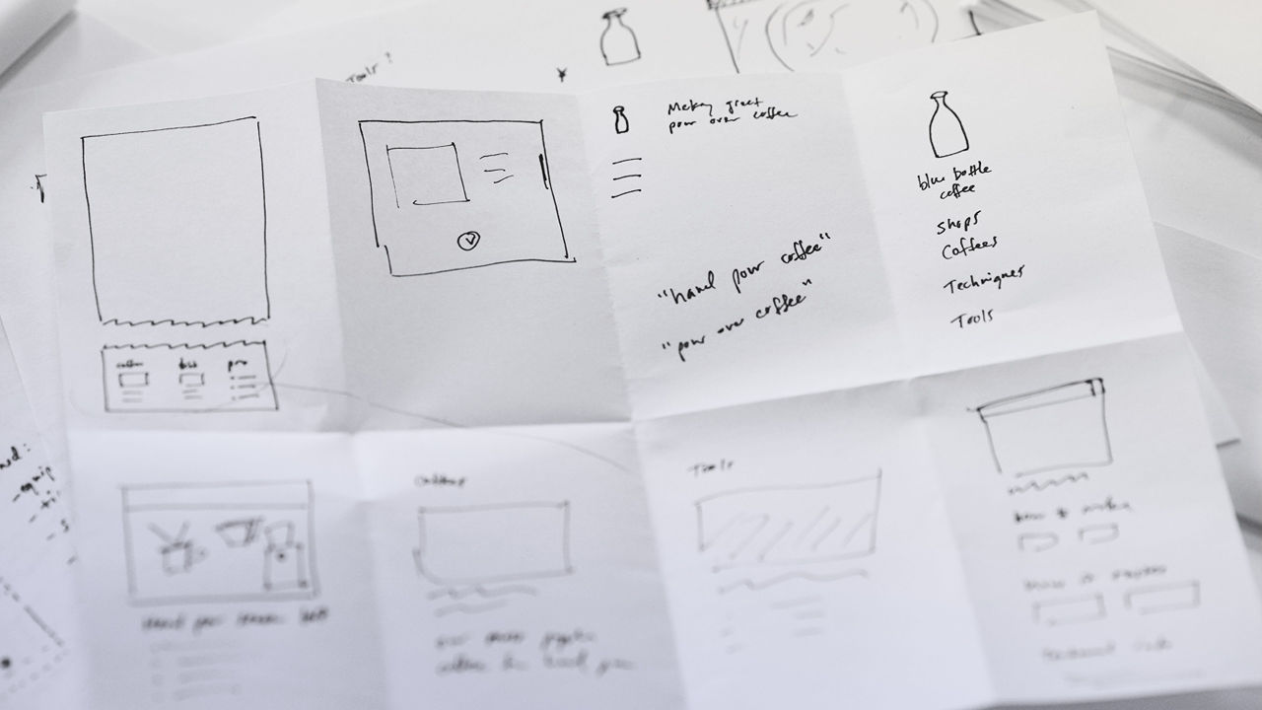
Crazy 8’s
Example One

Slide 34
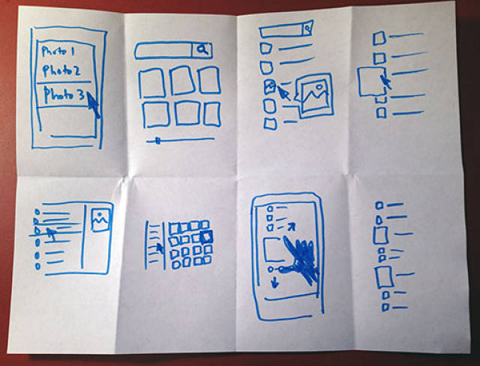
Crazy 8’s
Example Two

Slide 35
Repeat The Goals & Value
Communicate your goals of the sprint again and recap the value and what it means to your company/team.
POINT ONE
POINT TWO
POINT THREE
POINT FOUR

Slide 36
OBJECTIVE

Slide 37
START WITH THE QUESTION OF HOW MIGHT WE _____________ AND KEEP YOUR OBJECTIVE FOCUSED.
For example:
1. How might we define a better onboarding experience?
2. How might we promote trust inside our product when utilizing machine learning?
3. How might we automate and simplify creation for our customers?

Slide 38
TAKE SOME TIME TO GO OVER YOUR CRAZY 8 SKETCHES. COME UP WITH YOUR FINAL 2 CONCEPTS AND SKETCHES THAT YOU’D LIKE TO SHARE WITH THE REST OF THE GROUP.
30 MIN
Please keep our objective in mind.

Slide 39
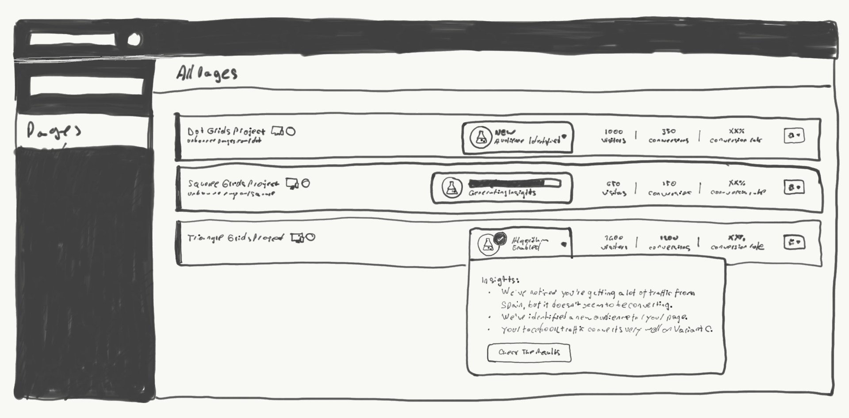
Example Concept
The algorithm will detect trends and notify you of new insights.

Slide 40
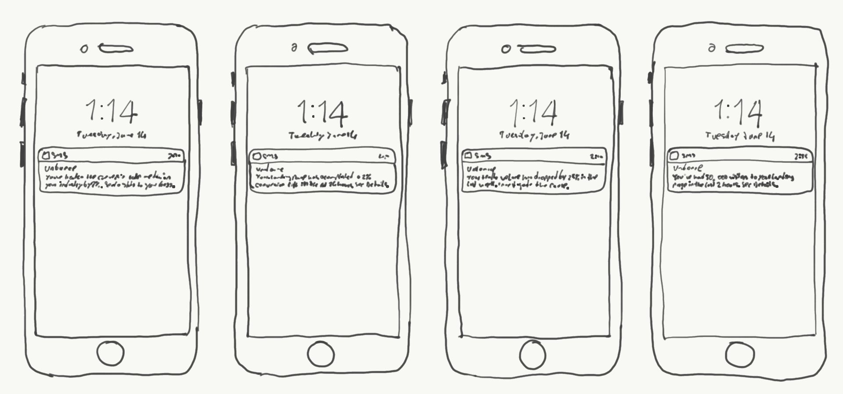
Example Concept
Alerts that notify you of significant changes in conversation rates or traffic. This would include both increases and decreases.

Slide 41
YOU HAVE 10 MIN TO PRESENT & DISCUSS.
45 MIN
Present your final two concepts to the group. Share how you kept the objective in mind and how you connected the dots with the objectives.

Slide 42
Rules of Engagement
1. Defer Judgement
3. Build on the Ideas of Others
Creative spaces don’t judge. They let ideas flow and foster great ideas.
Being positive and building on the ideas of others take some skill. In conversation, we try to use and instead of but...
2. Encourage Wild Ideas
4. Stay Focused on the Topic
Wild ideas can often give rise to creative leaps. Don’t be afraid of wacky and out there.
Keep the conversation on target. Otherwise you can diverge beyond scope or what we’re trying to design for.

Slide 43
Rules of Engagement
5. One Conversation at a Time
7. Go For Quantity
Always think about the challenge topic and give your input by joining a conversation not starting a new one.
Aim for as many ideas as possible. In a good session, up to 100 ideas are generated in 60 minutes. Crank the ideas out quickly.
6. Be Visual
8. Stay Analog
Nothing gets an idea across faster than drawing it. It’s all about the idea behind your sketch, not the drawing quality.
As much as possible, please leave your phones in your pockets and laptops closed (if you can!)

Slide 44
COFFEE
BREAK

Slide 45
YOU HAVE 10 MIN TO PRESENT & DISCUSS.
45 MIN CONTINUED
Present your final two concepts to the group. Share how you kept the objective in mind and how you connected the dots with the objectives.

Slide 46
Rules of Engagement
1. Defer Judgement
3. Build on the Ideas of Others
Creative spaces don’t judge. They let ideas flow and foster great ideas.
Being positive and building on the ideas of others take some skill. In conversation, we try to use and instead of but...
2. Encourage Wild Ideas
4. Stay Focused on the Topic
Wild ideas can often give rise to creative leaps. Don’t be afraid of wacky and out there.
Keep the conversation on target. Otherwise you can diverge beyond scope or what we’re trying to design for.

Slide 47
Rules of Engagement
5. One Conversation at a Time
7. Go For Quantity
Always think about the challenge topic and give your input by joining a conversation not starting a new one.
Aim for as many ideas as possible. In a good session, up to 100 ideas are generated in 60 minutes. Crank the ideas out quickly.
6. Be Visual
8. Stay Analog
Nothing gets an idea across faster than drawing it. It’s all about the idea behind your sketch, not the drawing quality.
As much as possible, please leave your phones in your pockets and laptops closed (if you can!)

Slide 48
OBJECTIVE

Slide 49
START WITH THE QUESTION OF HOW MIGHT WE _____________ AND KEEP YOUR OBJECTIVE FOCUSED.
For example:
1. How might we define a better onboarding experience?
2. How might we promote trust inside our product when utilizing machine learning?
3. How might we automate and simplify creation for our customers?

Slide 50
Design Sprint
Next Steps / Roti

Slide 51
Questions? Sharing!
#slack-channel-name
You can ask questions via Slack.

Slide 52
THANK YOU EVERYONE!
Facilitator Name (Title)
Facilitator Name (Title)

Slide 53
ANALYSIS & VOTING

Slide 54
The MIRO Board
1. Document all the ideas
3. How to vote
Collect all of the crazy 8’s into Miro / Realtime Board. Add descriptions under the crazy 8s so you can refer back to each one later.
Engineering votes on greatest feasibility, UX votes on what’s best for the user, PM votes on what’s best for the business, PMM votes on what’s most marketable.
2. Get everyone to vote
4. Concept Testing Candidates
After the sprint reach to each person in your session: PM, PMM, CS, Engineering, etc., to vote by their relative expertise.
Scale is from 1 to 3 (1 = not valuable, 3 = very valuable)
The final output has a total score and the top 10 are ideally concept testing.

